Slide 1
Communication
The exchange of information or passing of information, ideas or thought from one person to the other or from one end to the other is communication. According to McFarland communication is, “a process of meaningful interaction among human beings. More specifically, it is the process by which meanings are perceived and understandings are reached among human beings.” Newman and summer defined communication as “an exchange of facts, ideas, opinions or emotions by two or more persons.”

Slide 2
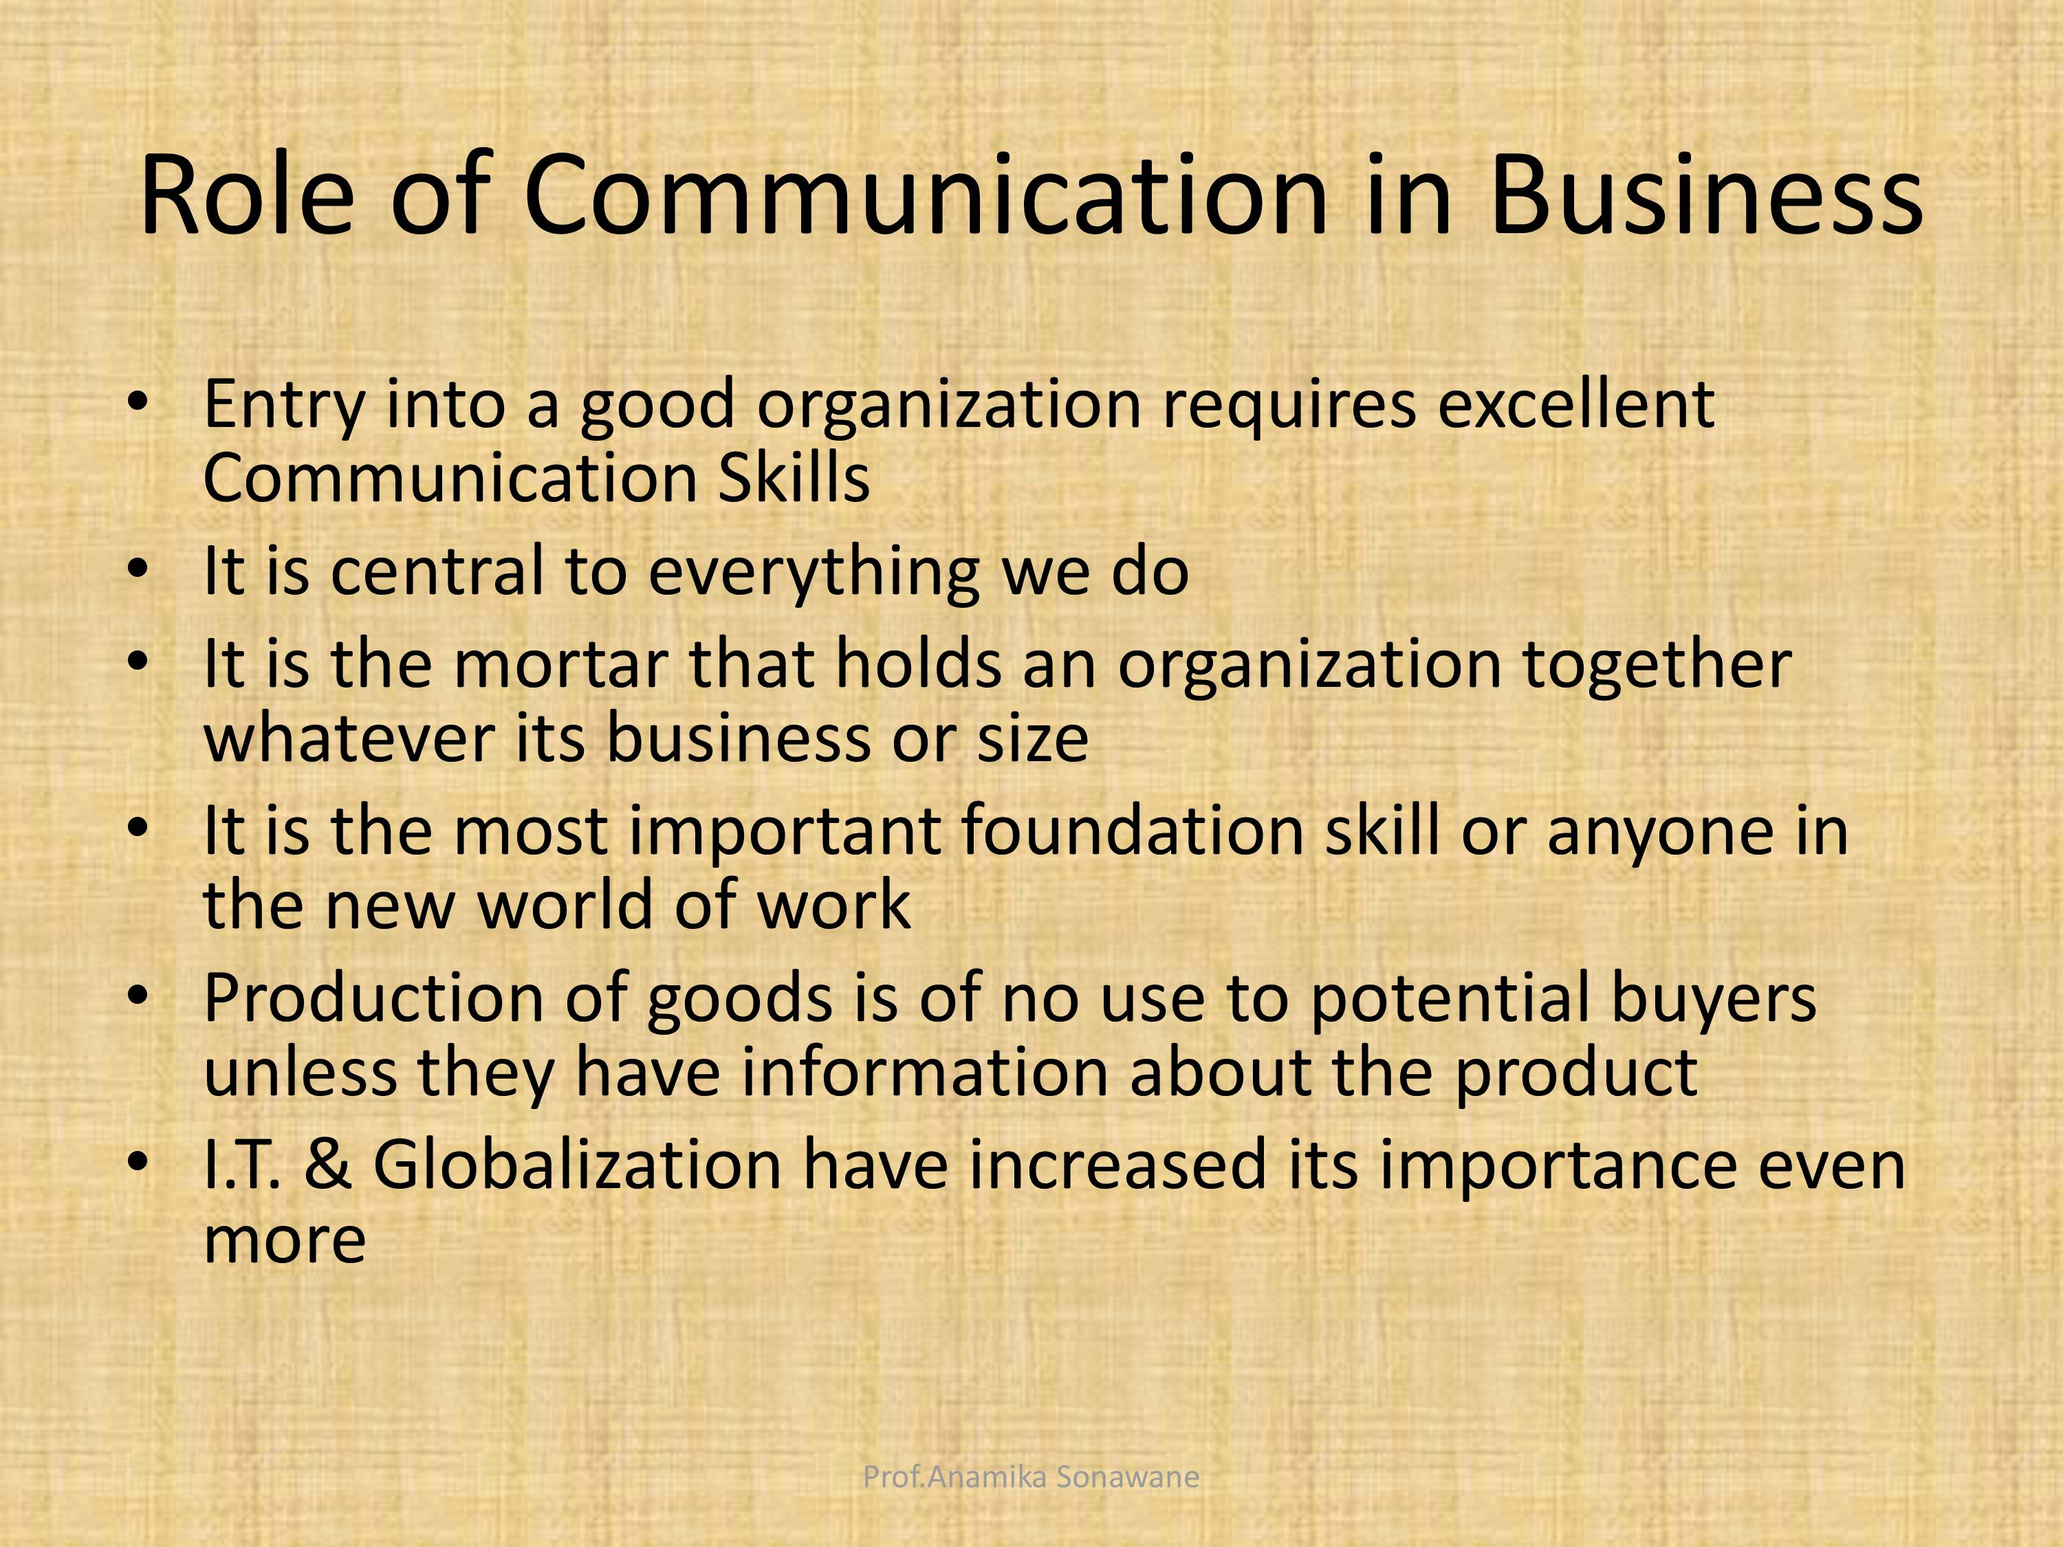

Slide 3
Components of communication
1. Context
It is the broad field that includes country, culture, organization, external and internal stimuli.
2. Sender-encoder
As a sender- encoder you use symbols that express your message and create the desired response.

Slide 4
3. Message
The core idea to communicate. It may be verbal and non-verbal.
Message is any signal that triggers the response of a receiver. The message can be written, oral, symbolic or non-verbal such as body gestures, silence, sighs, sounds, etc. or any other signal that triggers the response of a receiver.
4 Medium
Your medium can be the printed words, electronic mail, or sound.
5. Receiver- Decoder
The message receiver is your reader or listener.
6 Feedback
Feedback can be an oral or a written message, an action, or simply silence.

Slide 5
Types of communication Formal communication
Formal communication
The communication in which information flows through proper and pre-defined solutions is referred to as Formal Communication.
Formal communication is divided into different types according to its flow.
A set of commands is followed for formal communication whereas informal communication can move freely in all directions.
Formal communication is time-consuming, whereas it costs less time for informal communication.

Slide 6
Types of Formal Communication according to its flow
1. Vertical
In this type of formal communication, information exchange takes place at different organizational levels. Either the communication takes place from superior authority to subordinate or vice-versa. It is also classified into two types:
Bottom-up: Communication flow is from subordinate to superior authority.
Top-down: Communication flow is from superior authority to subordinate.

Slide 7
Types of Formal Communication
2. Lateral or Horizontal
This type of communication takes place between two employees of the same level but working in different departments. For example, communication that takes place between the Sales Manager and Human Resource Manager.
3. Diagonal or Crosswise
This type of communication takes place between employees of different departments working at different levels. For example, communication between Salesman and Manufacturing manager.

Slide 8
Informal Communication/ Grapevine
Informal communication is multidimensional, it flows freely in the organization without any restraint of predefined channels or routes. It is comparatively very quick and relational. In organizations it is often called the ‘grapevine’. It is also important for the growth of a company because employees can discuss work-related issues more openly which ultimately saves the company’s time and money. Some general examples are - chats between team members, a private journal or diary, etc.

Slide 9
Types of Informal Communication
1. Single Strand Chain
The communication in which one person tells something to another who again says something to another person and the process continues.
2. Cluster Chain
In this type of informal communication, one person tells something to some of his friends then they circulate that among their close friends and the process goes on.

Slide 10
Types of Informal communication
Probability Chain
In this type, one person randomly chooses some persons and transfers information to them and they also do the same later on.
4. Gossip Chain
This type of communication is very common in an organization, where a person tells something to a group of people then they also spread it further to another group of people till it gets passed to everyone.

Slide 11
Flow of Communication
There are 5 main types of communication flow within an organization: downward, upward, lateral, diagonal, and external.
Downward communication is communication that flows down from the higher levels of an organization to the lower levels, or down the chain of command. This type of communication transmits work-related information to lower level employees, which helps them to meet the expectations that have been set by their superiors. Managers use this communication to:
· Give feedback on an employee’s performance
· Relay instructions
· Provide understanding for an employee’s job, and the role it plays in the organization
· Communicating the mission and vision of the organization.

Slide 12
Upward Communication flow
Upward communication flows from the lower levels of an organization to the higher levels.
It helps to relay the effectiveness of downward communication and allows employees to convey their opinions and ideas.
Upward communications give employees a voice within the organization, to share their grievances, opinions, and ideas for the organization.
This allows for managers to work out any issues and keep the workplace a pleasant place to be.
This communication is facilitated through the Grievance Redressal System, Complaint/Suggestion Box, face-to-face conversations, etc.

Slide 13
Lateral Communication flow
Lateral communication is the exchange of knowledge or ideas between the people within an organization, community or units.
Lateral communication takes place at the same level of hierarchy within an organization, and is used to:
· Save time
· Facilitate co-ordination of tasks
· Facilitate co-operation among employees
· Solve problems within the organization
· Share information
· Resolve conflicts

Slide 14
Diagonal Communication flow
Diagonal communication is when a manager works with employees from another department or work group.
This is utilized in instances like when a manager is creating a training module and works with employees from various departments to ensure that the training is accurate, or when a project spans across multiple departments.
Effective diagonal communication leads to uniformity across an organization, and helps prevent any misunderstanding that may occur through the communication chain.

Slide 15
External communication flow
External communication is between a manager and an external group such as – vendors, suppliers, banks, etc.
This communication helps to ensure that the organization has all that it needs to be able to function properly.

